Slide 1

Dotnet Session 1
2/10/2023
Creating a basic notes ap i
Code Mentor Mauritius - Dotnet Sessions – Full Stack Web Development

Slide 2
Agenda
Learning plan of next weeks
Our Approach
API Creation
Code Mentor Mauritius - Dotnet Sessions – Full Stack Web Development

Slide 3
Our approach
Learn syntax
Get Certified Online
Do Projects To build portfolio
Interview Preparation
Internship with CodeMentorMU
Code Mentor Mauritius - Dotnet Sessions – Full Stack Web Development

Slide 4
Projects to-do to build a portfolio
Build an e-commerce App with React and .Net Core
Build your portfolio website with Three.js and React
Build Web APIs with .Net Core
10 basic API apps
School App API
More TBC
Task App API
Blog App API
POS App API
Booking App API
Directory App API
Membership App API
Job App API
Notes app API
Code Mentor Mauritius - Dotnet Sessions – Full Stack Web Development

Slide 5
Session 1 - Developing a notes app API
Demo
Code Mentor Mauritius - Dotnet Sessions – Full Stack Web Development

Slide 6
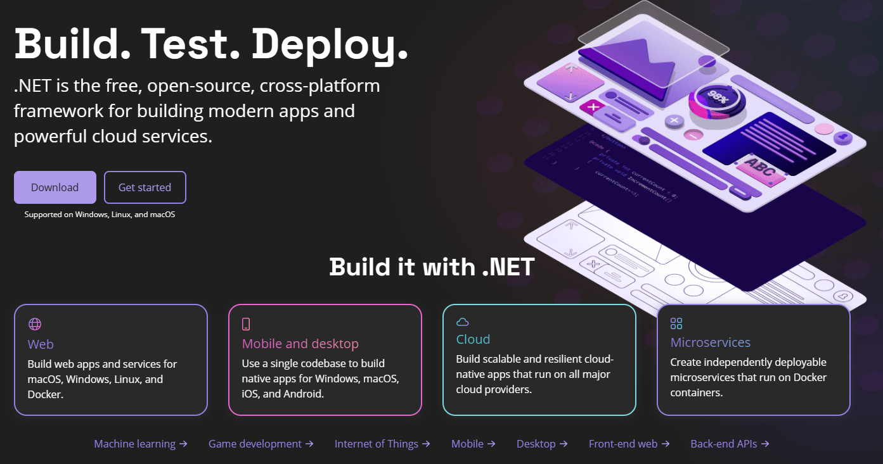
dotnet CLI download
https://dot.net/
Code Mentor Mauritius - Dotnet Sessions – Full Stack Web Development

Slide 7

dotnet CLI commands
dotnet –version
dotnet –h
Dotnet new list
Dotnet run
Code Mentor Mauritius - Dotnet Sessions – Full Stack Web Development

Slide 8
Creating our API project
1. Create a folder
NotesAppAPI
2. Open terminal or powershell in it
3. Create solution with:
dotnet new sln
4. Create API in NotesAPI folder with:
dotnet new webapi –o NotesAPI
5. Add that API project to our Solution csproj:
dotnet sln add NotesAPI
Code Mentor Mauritius - Dotnet Sessions – Full Stack Web Development

Slide 9
Creating our Entity class
1. In NotesAPI folder
Create a folder named Entities
2. Create a class
3. Add properties:
Type PROP and press enter
4. Create Id and Description properties:
public int Id { get; set; }
5. Open API.csproj and set Nullable as disable:
<Nullable>disable</Nullable>
Note.cs
public string Description { get; set; }
Code Mentor Mauritius - Dotnet Sessions – Full Stack Web Development

Slide 10

Creating our DbContext class
1. Open NugetGallery in VS Code
Search microsoft.entityframeworkcore
2. Install packages
3. Create a folder named:
Data
4. Create NotesContext.cs in Data folder
Derive from DbContext
5. Create constructor:
Microsoft.EntityFrameworkCore.Design and Microsoft.EntityFrameworkCore.SQlite
public class NotesContext : DbContext
Code Mentor Mauritius - Dotnet Sessions – Full Stack Web Development

Slide 11
Creating our DbContext class - continued
Add DbSet property to use it as table
public DbSet<Note> Notes { get; set; }
Code Mentor Mauritius - Dotnet Sessions – Full Stack Web Development

Slide 12
Inject DbContext to our dependency injection container for global use
1. In Program.cs, line 7, add:
builder.Services.AddDbContext<NotesContext>(opt => {opt.UseSqlite(builder.Configuration.GetConnectionString("DefaultConnection"));});
2. Open appSettings.Development.json
Add "ConnectionStrings": {"DefaultConnection": "Data Source= notes.db"}
Code Mentor Mauritius - Dotnet Sessions – Full Stack Web Development

Slide 13
Create and apply an Entity Framework Migration
2. Open terminal in VS Code
Run: dotnet tool install --global dotnet-ef --version 7.0.11
3. Create migration in NotesAPI folder
dotnet ef migrations add InitialMigration -o Data/Migrations
1. Google dotnet ef and get latest version from nuget.org
4. Create DB
dotnet ef database update
Code Mentor Mauritius - Dotnet Sessions – Full Stack Web Development

Slide 14

Creating our API
2. Add constructor
public NotesController(NotesContext context){}
3. Inject NotesContext
1. Create an API controller class
4. Create GET Endpoint
[HttpGet] public ActionResult<List<Note>> GetNotes(){return context.Notes.ToList();}
NotesController
5. Create POST Endpoint
[HttpPost] public void AddNote(Note note){ context.Notes.Add(note); context.SaveChanges();}
Code Mentor Mauritius - Dotnet Sessions – Full Stack Web Development

Slide 15

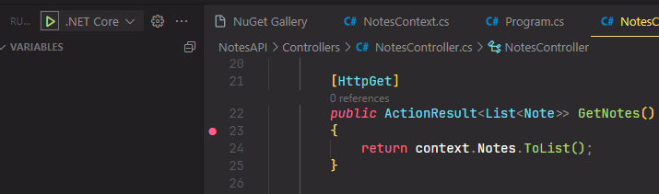
Enable VS Debugging
1. CTRL + Shift + P
Set breakpoint and Run
Code Mentor Mauritius - Dotnet Sessions – Full Stack Web Development

Slide 16
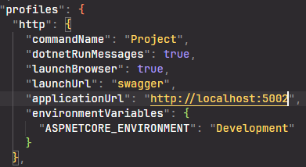
Set launch port as fixed 5002
Open properties folder
Remove unused
profiles and unused IIS settings
Open LaunchSettings.JSON
Code Mentor Mauritius - Dotnet Sessions – Full Stack Web Development

Slide 17
Add CORS
In Program.cs add:
// enable cors
builder.Services.AddCors(cors => cors.AddPolicy("corsPolicy", build =>
{
build.WithOrigins("http://127.0.0.1:5500/").AllowAnyMethod().AllowAnyHeader().AllowAnyOrigin();
}));
Replace http://127.0.0.1:5500/ with your client app url
After var app = Builder.build() add:
app.UseCors("corsPolicy");
Code Mentor Mauritius - Dotnet Sessions – Full Stack Web Development

